Slide 1

CentWise:
Collaborative Expense Tracking
application
Ashay Saoji - 002766044
Kshiti Dangore - 002783373
Manan Vijayvargiya - 002270765
Yash Limbodiya - 002284031

Slide 2
CentWise:
🌟About:
1. Expense Tracking:
CentWise allows users to record and track shared expenses in real-time. Users can input details such as the amount spent, the purpose of the expense, and the participants involved.
2. Bill Splitting:
The application provides a convenient way to split bills among multiple individuals. Whether it's splitting the rent, utilities, groceries, or any other shared expense, CentWise ensures a fair and accurate distribution of costs.
3.Collaborative Platform:
CentWise operates as a collaborative platform, enabling users to invite others to join expense groups. This is particularly useful for roommates, friends, or colleagues who regularly share expenses.

Slide 3
CentWise:
🚀Key Features:
Expense Tracking: A. Easily log and categorize shared expenses. B. Settle Up logged expenses
Real-time Balances: Keep track of who owes money and who is owed in real-time
Group Bill Splitting: Calculate and distribute costs among group members
View Charts: Visual representation of the amount you owe and the amount you are owed in the form of pie-charts
Invite friends: Send an email to friends using the invite friends functionality
Internationalization in UI: The basic keywords can be viewed in Hindi and Tamil apart from English

Slide 4
CentWise:
🚀Additional Features:
Login and Signup: Allows user to create a new profile or login into existing account.
Forgot password functionality: Allows user to reset their password, with the forgot password functionality, using the nodeMailer
Google Authentication: Users can create and log-in into the application using their google accounts
Update User Profile: Allows user to update the personal profile details
Profile picture: Used Multer to add the functionality for uploading and updating user profile display picture

Slide 5










Thhsahs
CentWise:
⚙️Technologies Used:

Slide 6
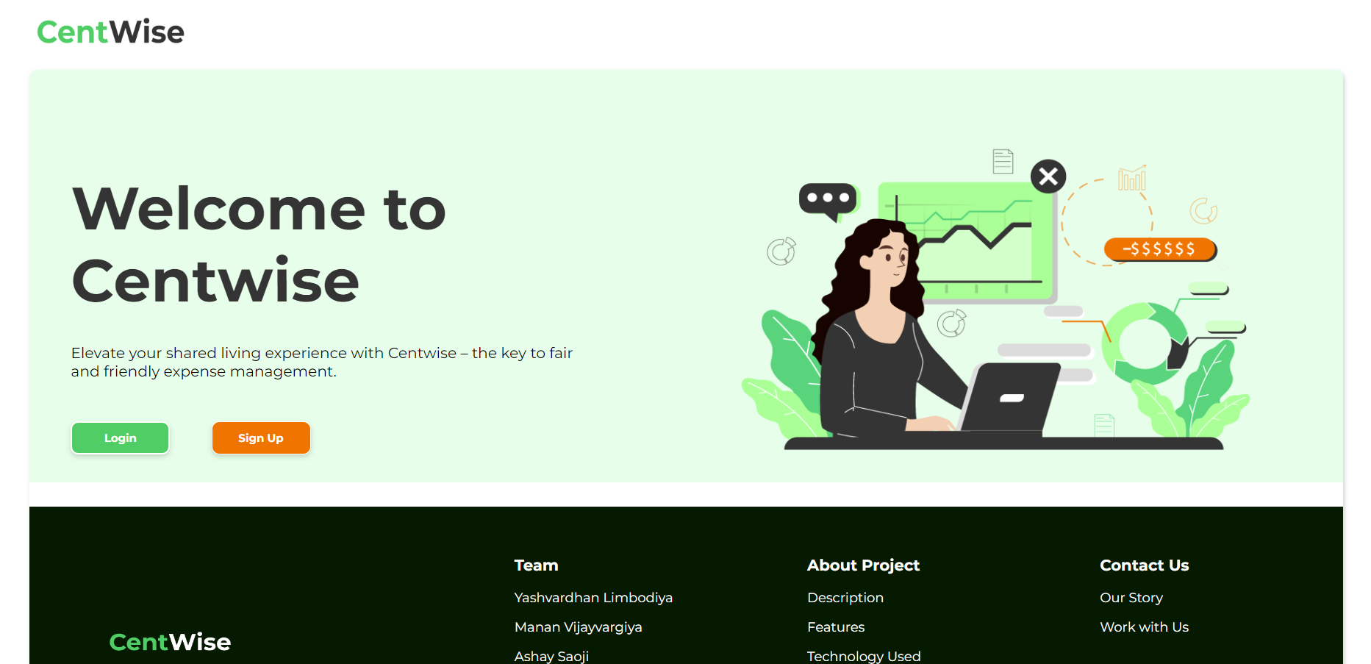
CentWise: Screenshots
⚙Landing Page of our application:

Slide 7
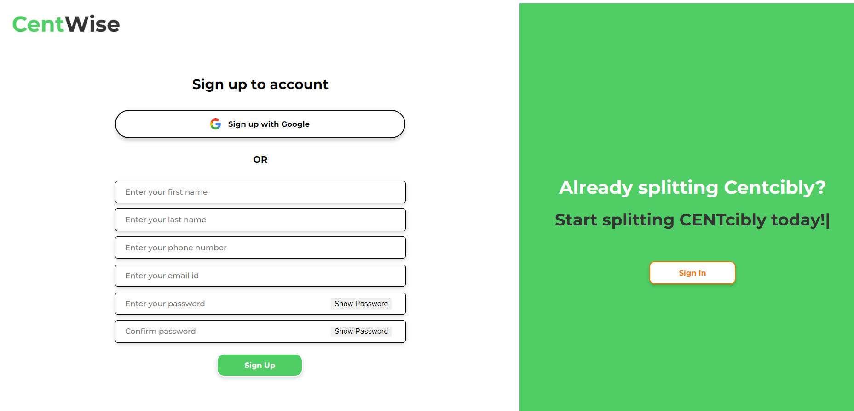
CentWise:
⚙Sign-up page:

Slide 8
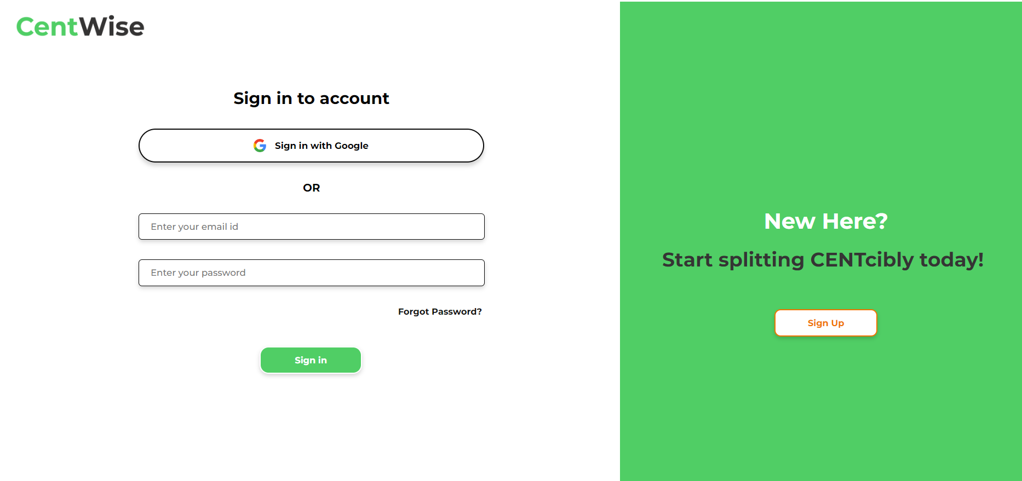
CentWise:
⚙Sign in page:

Slide 9
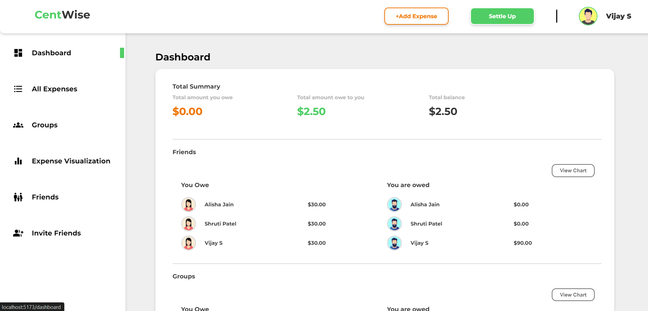
CentWise:
⚙️Dashboard:

Slide 10
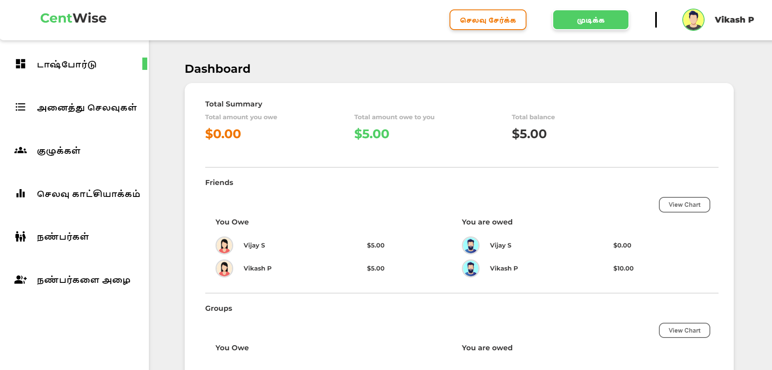
CentWise:
⚙Tamil Language in UI:

Slide 11
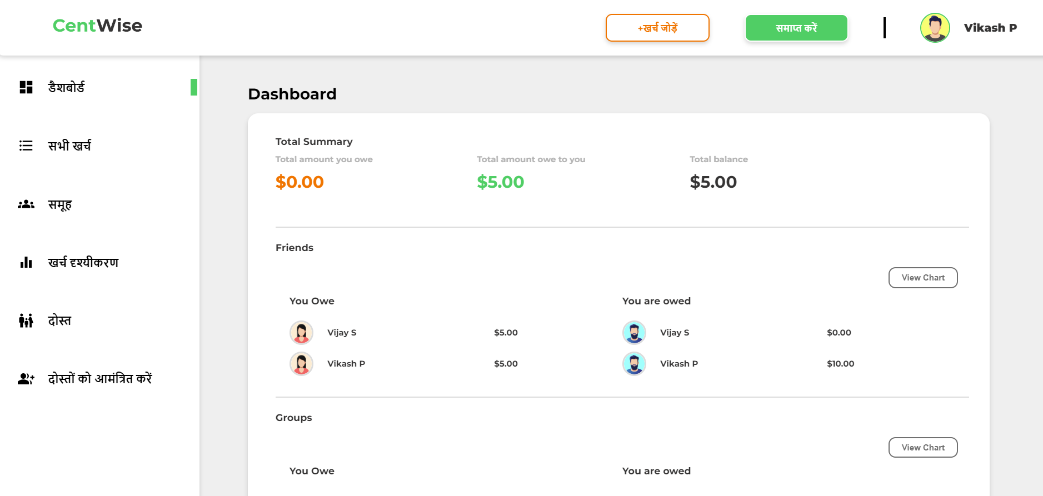
CentWise:
⚙Hindi language in the UI

Slide 12
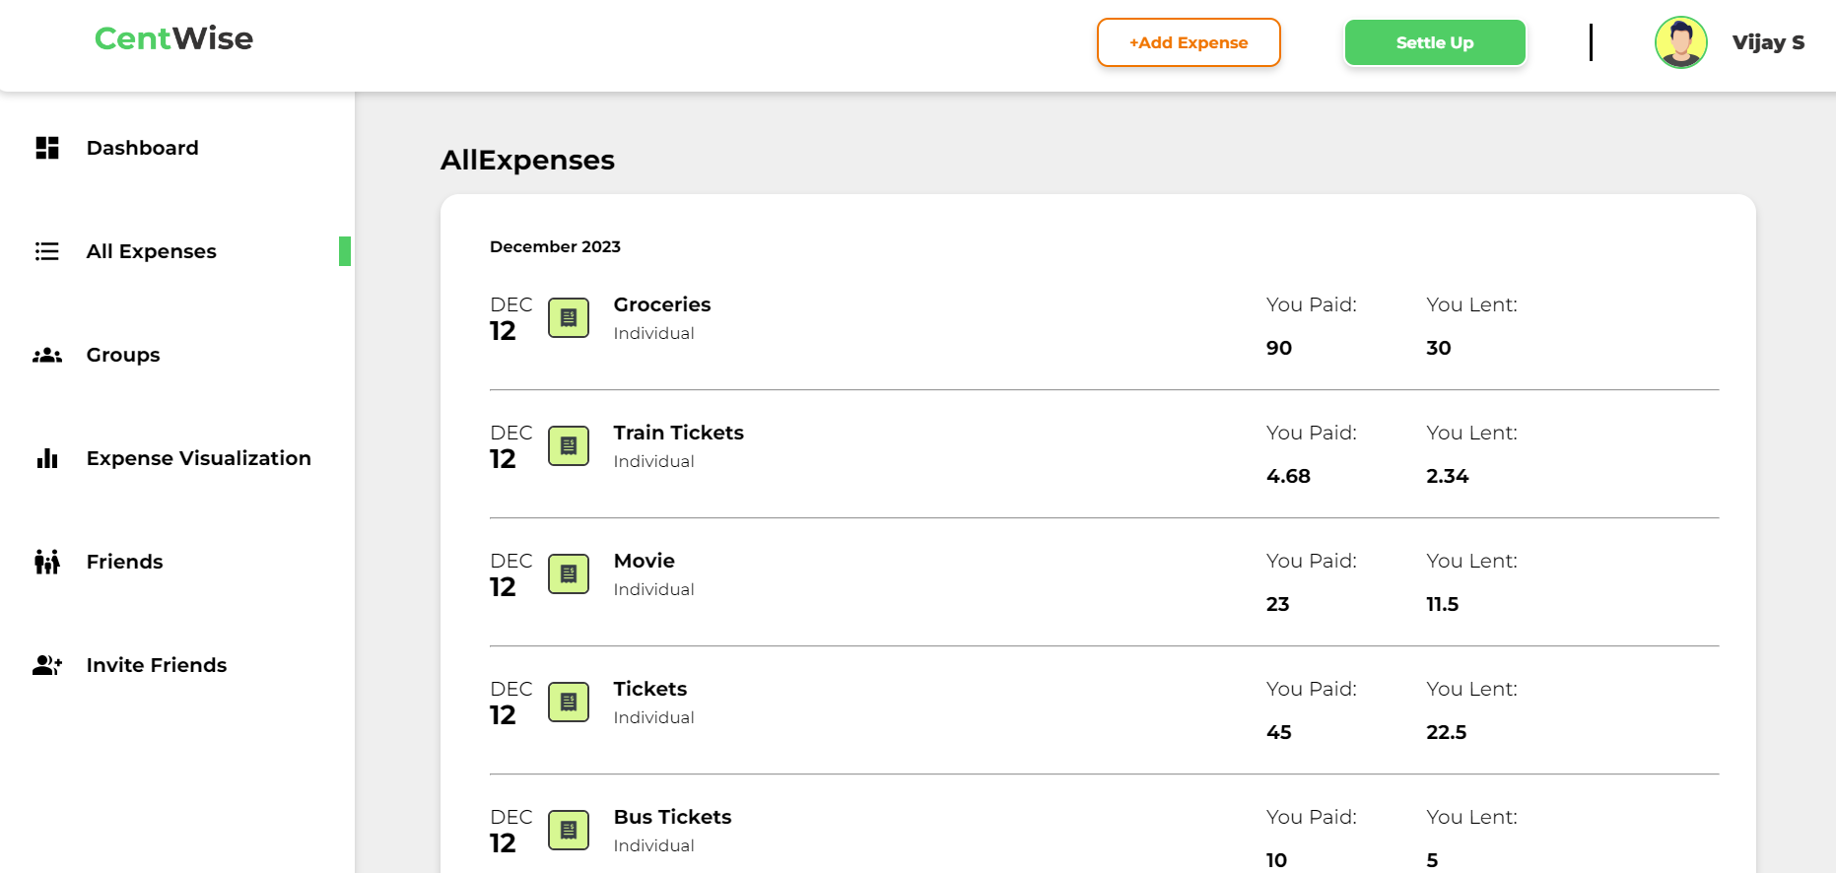
CentWise:
⚙All Expenses:

Slide 13
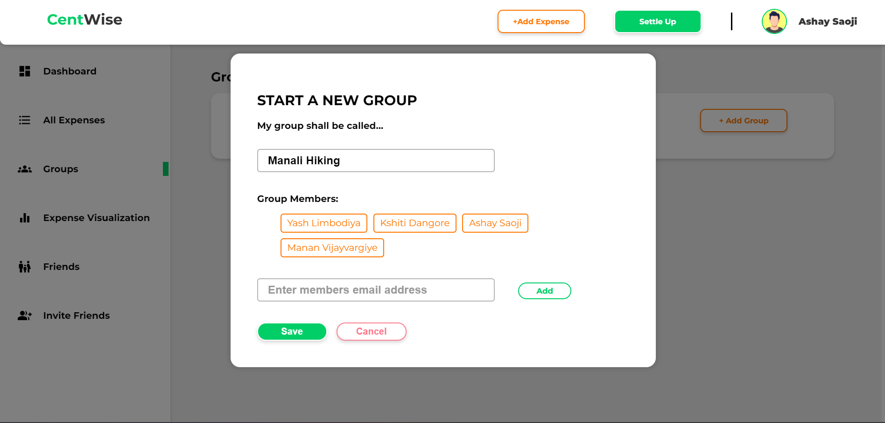
CentWise:
⚙Start a new group Modal:

Slide 14
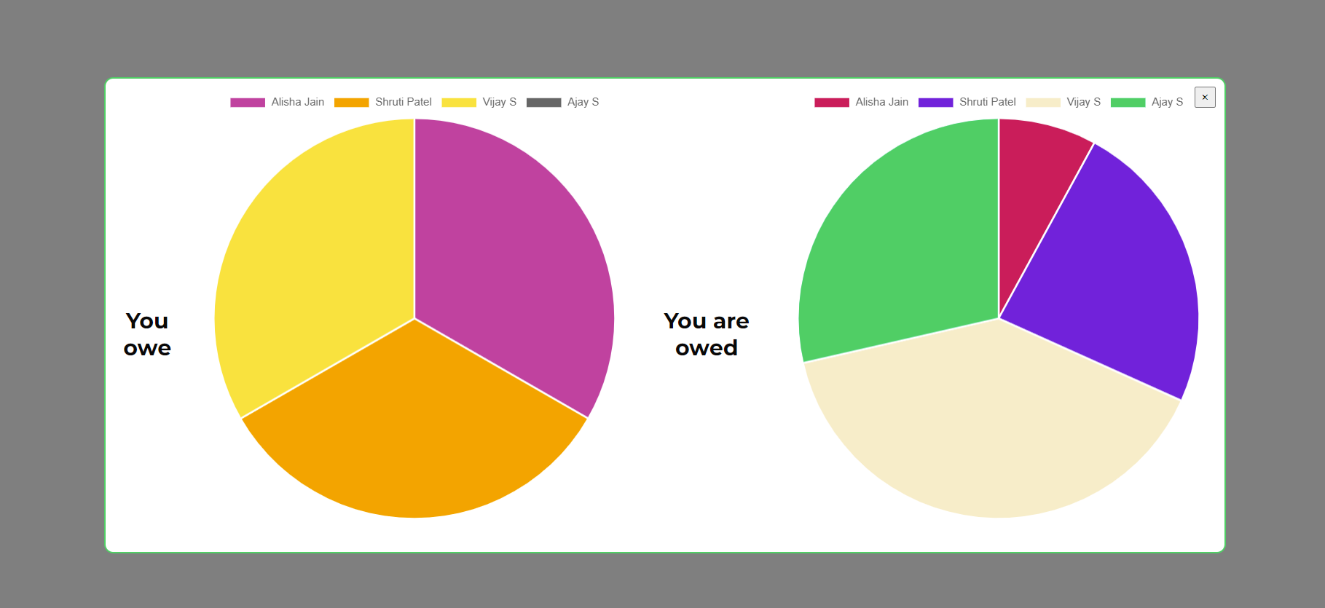
CentWise:
⚙View Charts functionality:

Slide 15
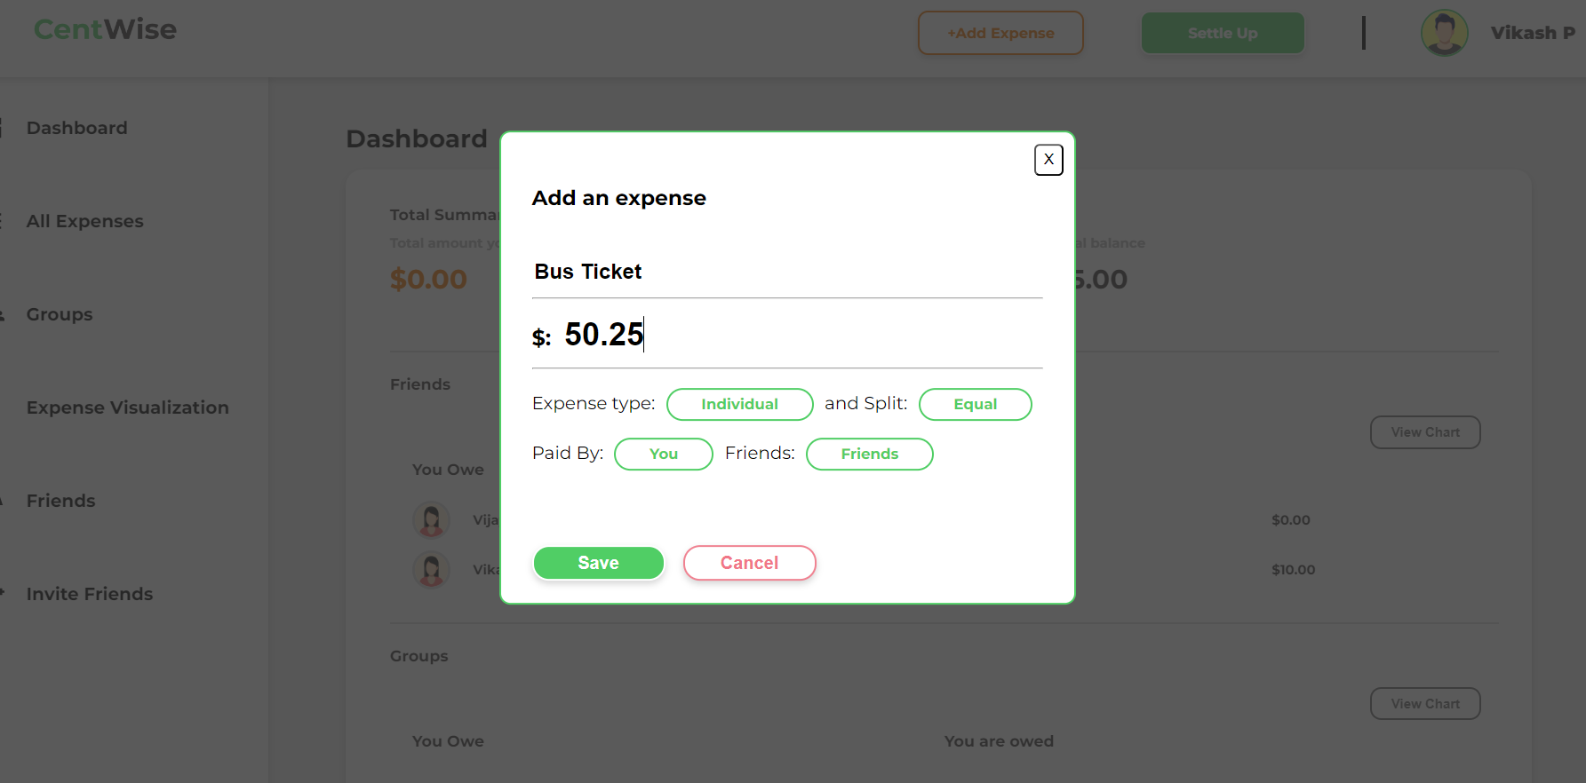
CentWise:
⚙Add an expense modal:

Slide 16
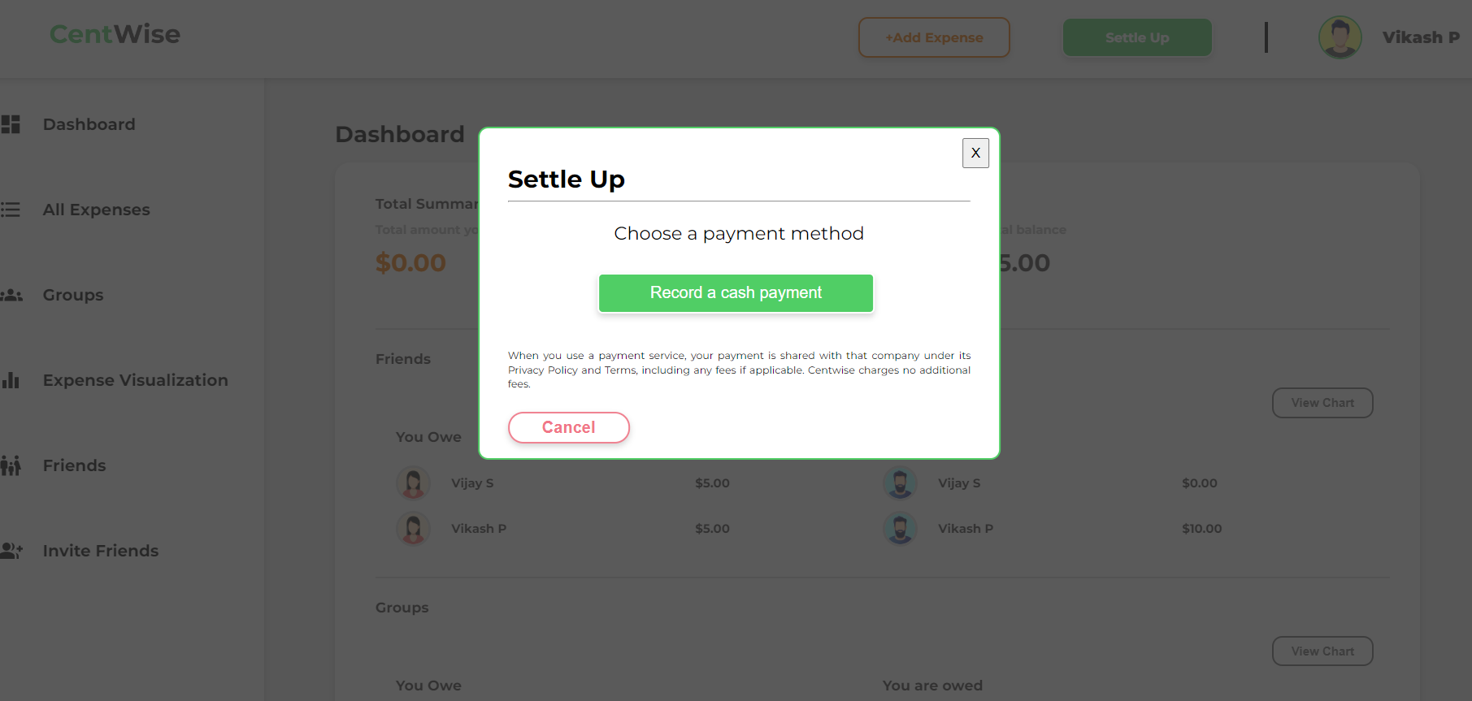
CentWise:
⚙Settle Up modal:

Slide 17
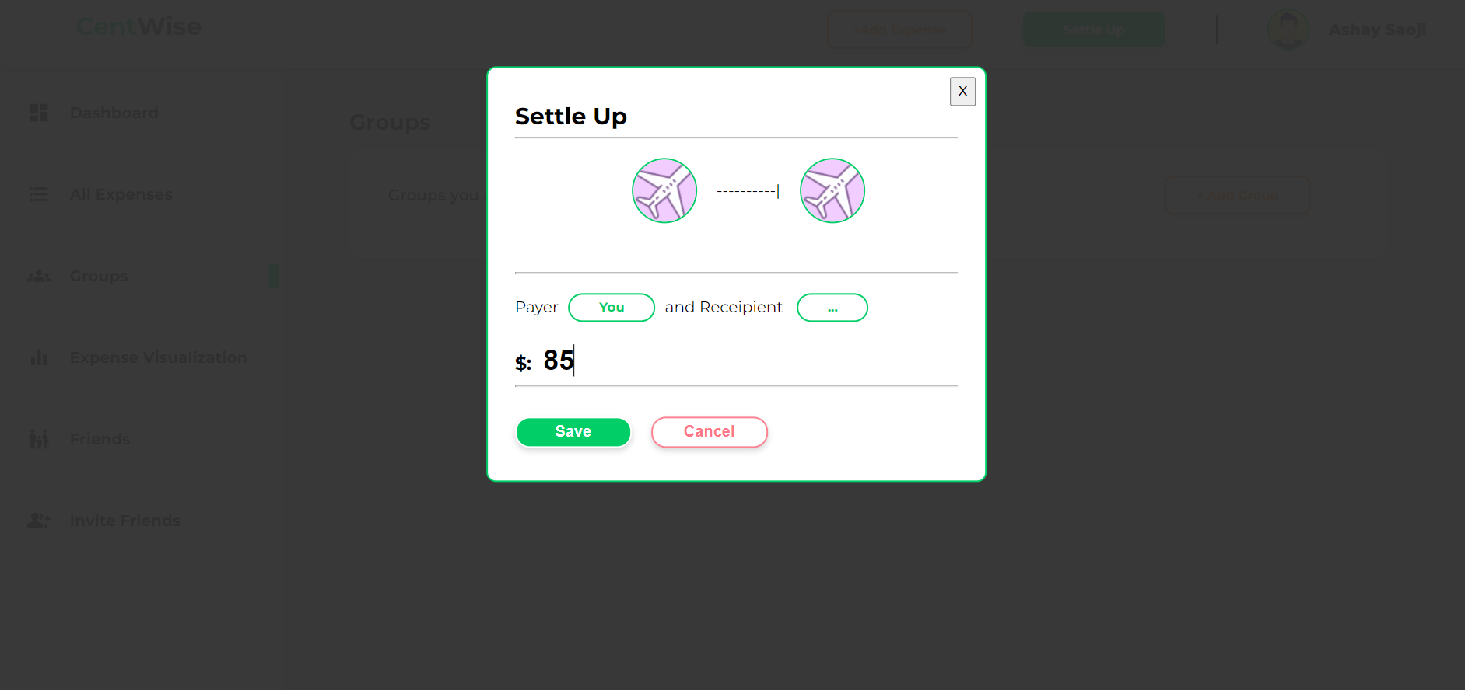
CentWise:
⚙Settle Up modal on click:

Slide 18
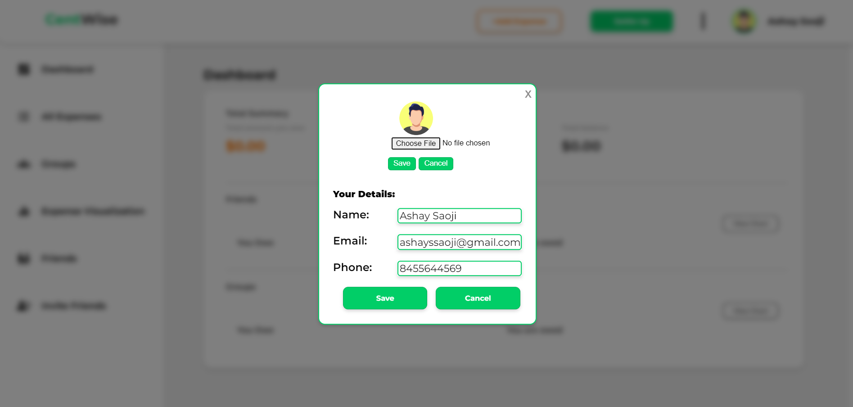
CentWise:
⚙Editable Profile:

Slide 19
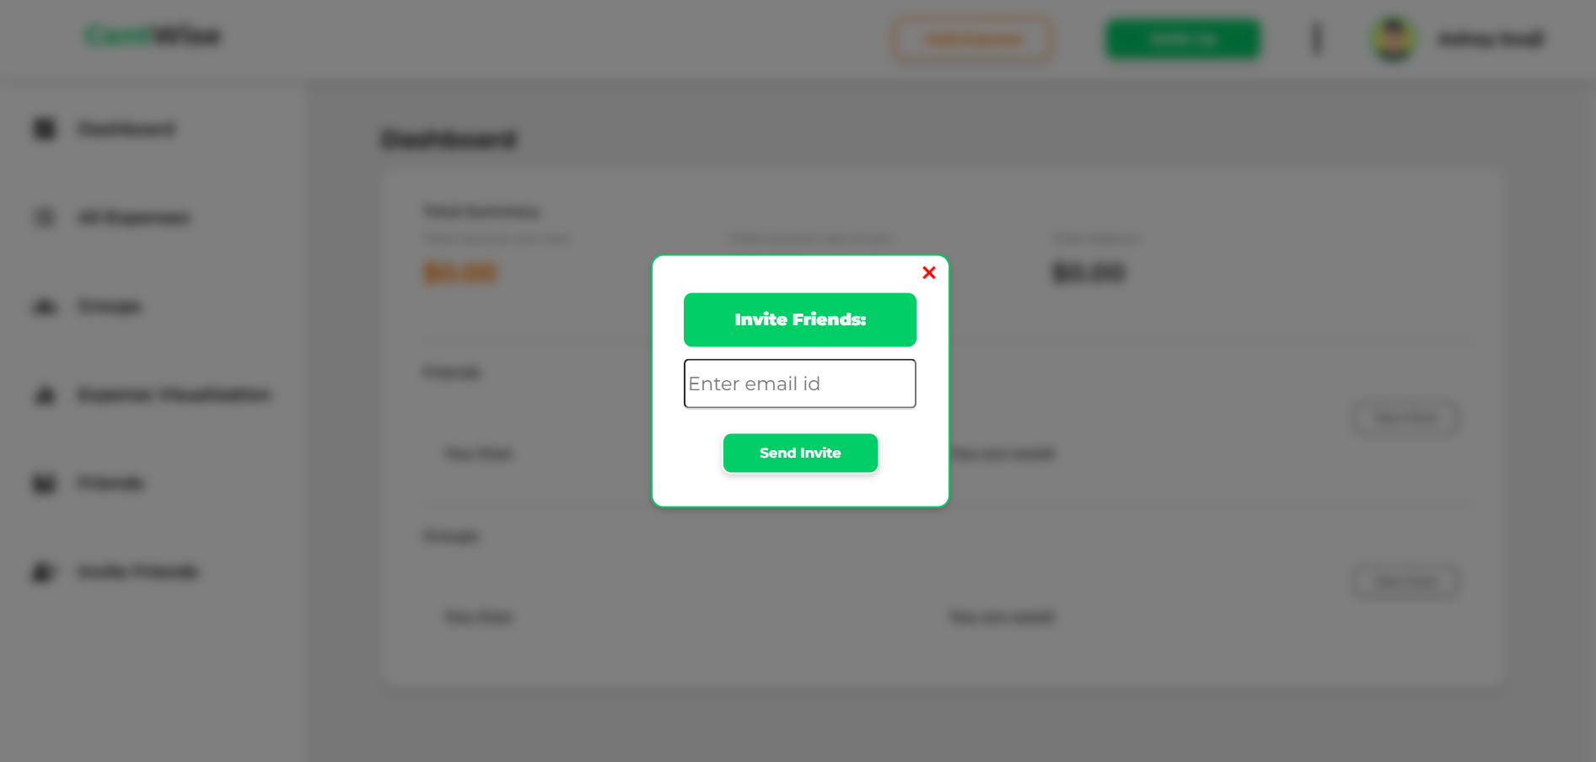
CentWise:
⚙Invite Friends Modal:

